Slide 1


Top Trumps
Presented by Sarah²

Slide 2

Project Brief:
Generate a random number between 1 and 151 to use as the Pokemon ID number
Using the Pokemon API get a Pokemon based on its ID number
Create a dictionary that contains the returned Pokemon's name, id, height and weight
Get a random Pokemon for the player and another for their opponent
Ask the user which stat they want to use (id, height or weight)
Compare the player's and opponent's Pokemon on the chosen stat to decide who wins

Slide 3
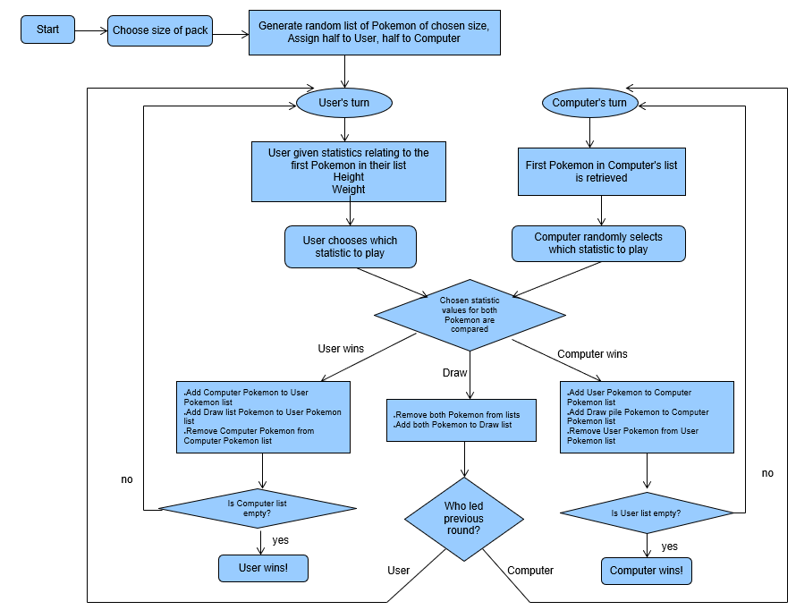
User flow chart:

Slide 4
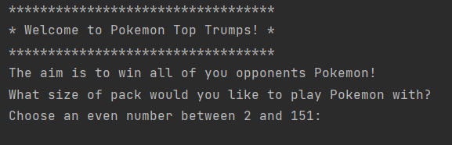
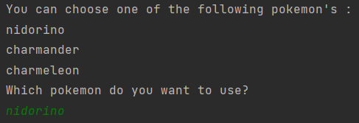
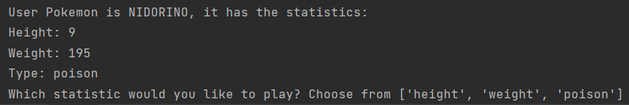
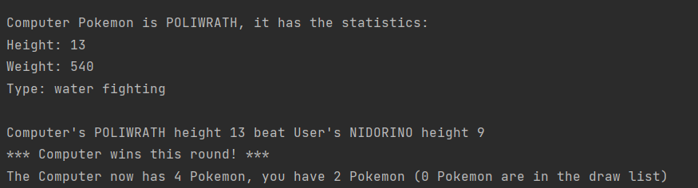
Initial code and game output:

Slide 5
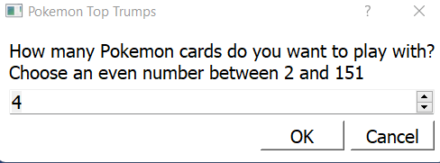
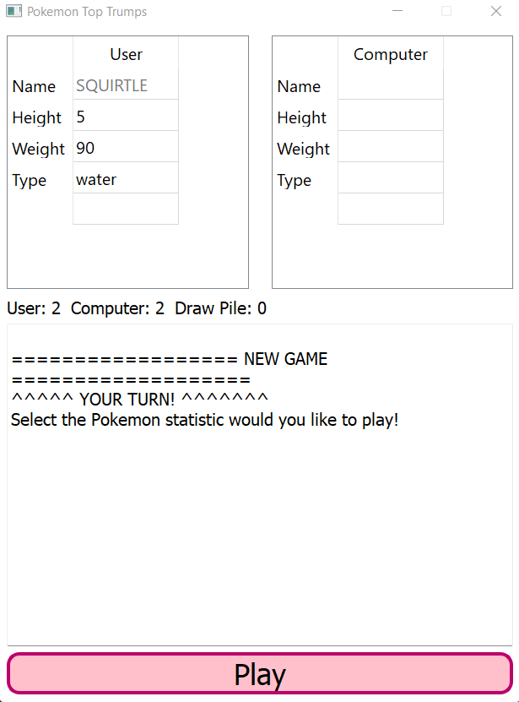
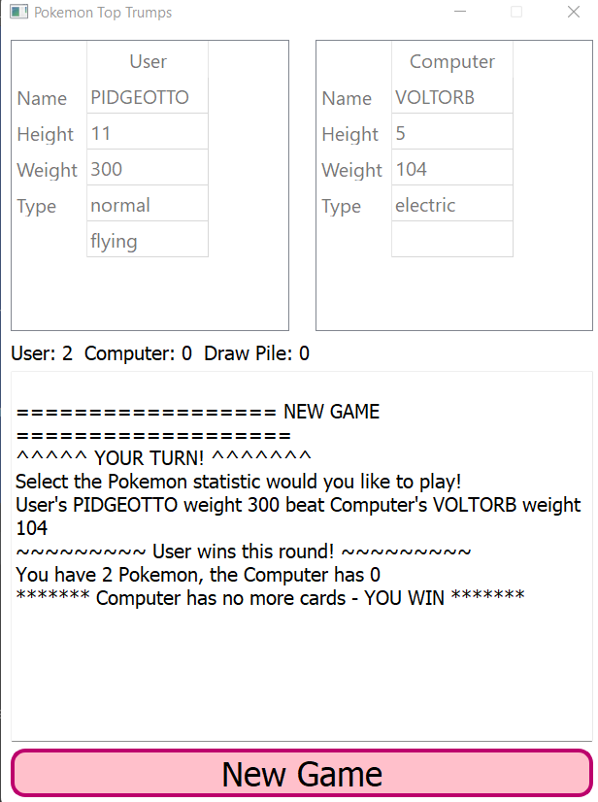
Extending the project using gui:
We chose PYQT5
In order to use it you need to download Python 3.9 and install pyqt5 pyqt5-tools

Slide 6
Demonstration

Slide 7
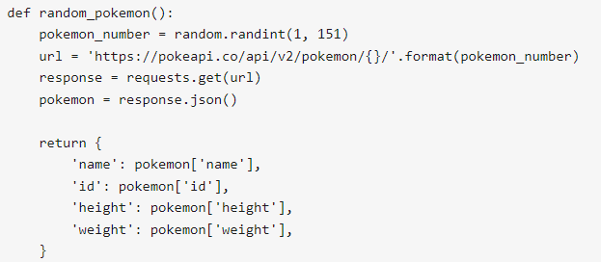
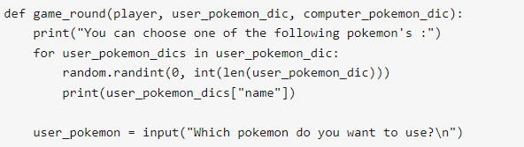
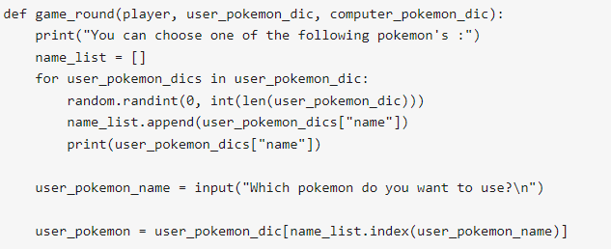
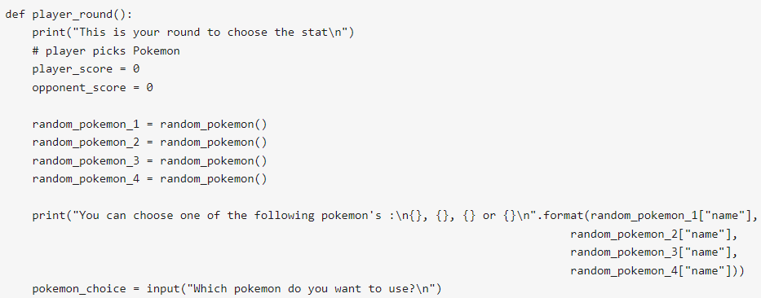
One of the challenges we faced:
Allowing user to pick the Pokemon character card they wanted to use
Initial instinct:
Development:
Solution:

Slide 8
Thank you for your time
Any questions?

